Slide 1
Hidden Markov Models

Slide 2
Overview
Markov models
Hidden Markov models(HMM)
Issues Regarding HMM
Algorithmic approach to Issues of HMM

Slide 3
Markov Models
A Markov model is a finite state machine with N distinct states begins at (Time t = 1) in initial state .
It moves from current state to Next state according to the transition probabilities associated with the Current state
This kind of system is called Finite or Discrete Markov model.

Slide 4
Markov Property
Markov Property : The Current state of the system depends only on the previous state of the system (Memory Less)
The State of the system at Time [ T+1 ] depends on the state of the system at time T.
X_{t=1}
X_{t=2}
X_{t=3}
X_{t=4}
X_{t=5}

Slide 5
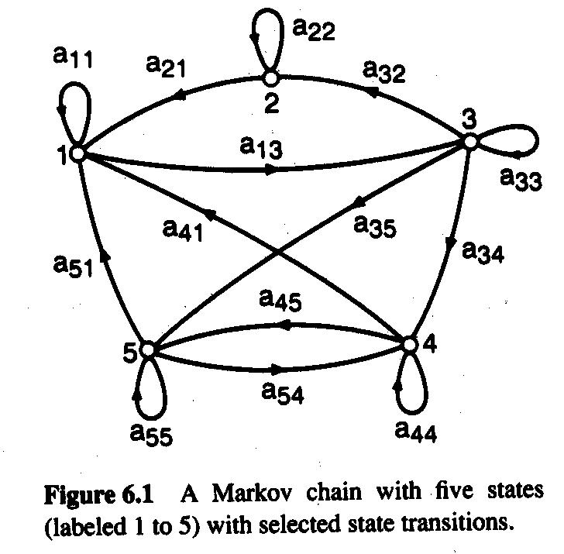
Discrete Markov Model : Example
A Discrete Markov Model with 5 states.
Each aij represents the probability of moving from state ‘ i’ to state ’j’.

Slide 6
Example
The probability to start in a given state I is π_{i}.
The Vector π represents the start probabilities.
To define Markov model, the following probabilities have to be specified: transition probabilities aij = P(Si | Sj ) and
initial probabilities
π_{i} = P( Si )

Slide 7
Hidden Markov Models
A Hidden Markov model is a statistical model in which the system being modelled is assumed to be markov process with unobserved hidden states.
In Regular Markov models the state is clearly visible to others in which the state transition probabilities are the parameters only where as in HMM the state is not visible but the output is visible.

Slide 8
Description
It consists of set of states : S1,S2,S3…….sn.
Process moves from One state to another state generating a sequence of states Si1,Si2,….Sik…
Markov chain property: probability of each subsequent state depends only on what was the previous state
P( Sik | Sk1,Si2,……..Sik-1) = P ( Sik | Sik-1)
States are not visible, but each state randomly generates one of M observations (or visible states)
V = { v1,v2,v3…..vk…..}

Slide 9
Essentials
To define hidden Markov model, the following probabilities have to be specified: matrix of transition probabilities A=(a_{ij}), a_{ij}= P(s_{i} | s_{j}) , matrix of observation probabilities
B=(b_{i} (v_{m} )), b_{i}(v_{m} ) = P(v_{m} | s_{i}) and a vector of initial probabilities π=(π_{i}), π_{i} = P(s_{i}) . Model is represented by M=(A, B, π).

Slide 10
Hidden Markov model ( Probabilistic finite state automata )
The Scenarios where states cannot be directly observed.
We need an extension i.e, Hidden Markov Models
a₁₁
a₂₂
a₃₃
a₄₄
a₁₂
a₂₃
a₃₄
b₁₁
b₁₄
b₁₃
b₁₂
4
1
2
3

Slide 11
Hidden Markov model
a_{ij} are state transition probabilities.
b_{ik} are observation (output) probabilities.
b₁₁ + b₁₂ + b₁₃ + b₁₄ = 1,
b₂₁ + b₂₂ + b₂₃ + b₂₄ = 1.

Slide 12
Hidden Markov Models - HMM
Hidden variables
H₁
H₂
H_{i}
H_{L-1}
H_{L}
X₁
X₂
X_{i}
X_{L-1}
X_{L}
Observed data

Slide 13
Main issues ?
Evaluation problem: Given the HMM
M = { A, B, π } and observation sequence
O = o1,o2 ……ok, Caluculate the probability that model m has generated sequence O.
Decoding problem : : Given the HMM
M = { A, B, π } and observation sequence
O = o1,o2 ……ok, Caluculate the most likely sequence of hidden states Si that generated sequence O.

Slide 14
Problems ?
Learning Problem : Given some training observation sequences O = o1,o2 ……ok, and general structure of HMM( visible and hidden states) Determine HMM parameters that best fit the training data.

Slide 15
Solutions to evaluation problem ?
Evaluation problem: For this problem We use an Forward- Backward algorithm
This algorithm mainly consists of defining a forward or backward variable as the joint probability of partial state sequence such as
O = o1, o2, …..ok and the hidden state Si at time k is αk(i) = p(o1 o2 o3…ok, Qk = Si).
The three states in this algorithm are initilaisation, forward recursion and termination.

Slide 16
Solutions to learning problem
The solution to this problem is to estimate parameters.
The parameters that need to be estimated are Transmission probabilities and emission probabilities. Since they sum upto 1, only 2 transmission and 2 estimation parameters are to be found.
More parameter estimation be done using
Baum-Welch algorithm

Slide 17
Solution to decoding problem ?
Decoding problem: Viterbi Algorithm
In this algorithm we go through the observations from start to end referring a state of hidden machine for each observation.
We also record the values of Overall Probability,
Viterbi path (sequence of states) and the viterbi probability( Probability of observed state sequences in viterbi path )
The probability of possible step given its corresponding observation is probability of transmission times the emission probability.

Slide 18
Viterbi algorithm
Overall Probability : Multiply each new probability with the old one.
Viterbi probability : Take the highest next step probability and multiply with the next step viterbi probability.
Viterbi path : Add the next step path to viterbi path.

Slide 19
Viterbi algorithm with example
A person basically does 3 activities walk, clean and shop depending on the weather conditions?
Possibility of weather conditions are ‘Rainy’ and ‘sunny’.
In this example weather condition states are hidden and we will know the weather condition by her activities.

Slide 20
Viterbi algorithm with example
As we discussed in earlier slides for every hidden markov model ( HMM ) we need an Transition probabilities and Emission probabilities.
The transition probabilities are :
P( R ---> R) (Rainy stays rainy) = 0.7
P( R ---> S) ( Rainy turns into Sunny ) = 0.3
P ( S ---> S) ( Sunny stays into sunny ) = 0.6
P ( S----> R) (Sunny turns into rainy ) = 0.4

Slide 21
Viterbi algorithm with example
The Observations of her activities is
If it is Rainy the behaviour is
Walk = 0.1
Clean = 0.5
Shop = 0.4
If it is Sunny the behaviour is
Walk = 0.6
Clean = 0.3
Shop = 0.1

Slide 22
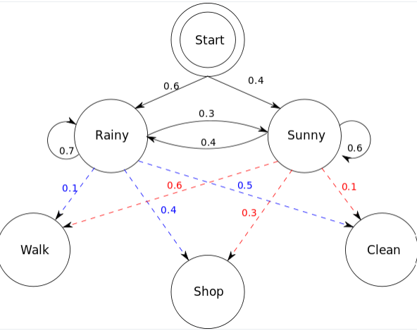
Viterbi algorithm with example

Slide 23
Viterbi algorithm with example
If the observations are WCSW
Then according to algorithm find the overall prob, vit Prob, vit_path.
In vi_path you get the sequence of states which need to compare with the original states in order to know the accuracy
Through many examples the accuracy varies between 80-90%

Slide 24
Applications of HMM
Cryptanalysis
Speech Recognition
Pattern Recognition
Activity Recognition
Machine Translation

Slide 25
References
http://en.wikipedia.org/wiki/Hidden_Markov_model
www.evl.uic.edu/shalini/coursework/hmm
www.cedar.buffalo.edu/~govind/CS661/Lec12.ppt
www.bios.niu.edu/johns/bioinf.../Hidden%20Markov%20Models.ppt
www.ece.drexel.edu/gailr/ECE-S690-503/markov_models.ppt.pdf

Slide 26
Thank you

